Slide 1
Breast self examination
Ms. Neha Bite

Slide 2
Introduction: The Breast
It has an important role in women’s life
Often viewed as measures of sexuality , femininity and attractiveness because it is visible for its size and shape.
However, it is a secondary sex characteristic
Its physiologic function is milk secretion to feed infants

Slide 3
Recommendations
All women age 20 years and older should perform BSE on a monthly basis. Beginning in their 20’s, women should be told about the benefits of breasts self examination.
All women ages 29 to 39 should have clinical examinations every 3 years
All women ages 40 years and older have regular (every 1 to 2 years) mammograms.
Asymptomatic women ages 40 and older should continue to receive clinical breast examination
Screening decisions for older women should be individualized by considering the potential benefits and risk of mammography in the context of the current health status and estimated expectancy.

Slide 4
Advantages of BSE
Women can use BSE to asses their breasts.
When they perform BSE properly and regularly, they can note any changes in their breasts and seek further evaluation.
Experience has verified that 90% of breast cancers are found by women themselves
When women discover lumps in their breasts at a very early stage, surgery can save 70- 80% of proven cases

Slide 5
Barrier to BSE
The major barriers to BSE is the lack of
CONFIDENCE
PRIVACY
KNOWLEDGE

Slide 6
Methods used for examination
By inspection
By palpation

Slide 7
On inspection
On examination it should be:
Symmetrical, full, rounded, smooth in all portions, without dumpling, retractions or masses
Faint, even vascular pattern and striae are noted
Nipples everted, areola even
Axillae even color, without masses or rash

Slide 8
On palpation
The breast should be
Firm and without masses, lumps, local areas with warmth, or tenderness
Nipples should have no discharges
Axillae should be smooth and node are nonpalpable

Slide 9
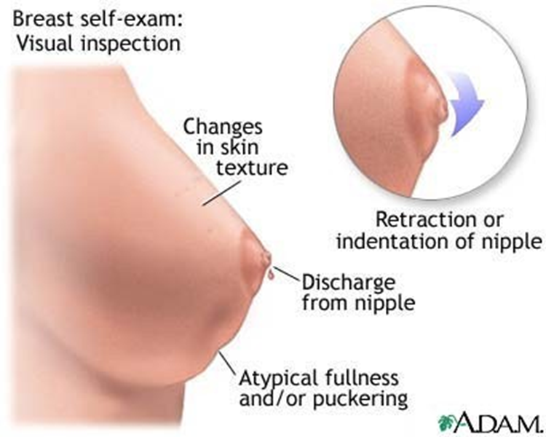
Signs of breast cancer
Elevation
Asymmetry
Bleeding
“Orange Peel” skin
Nipple Retraction

Slide 10
Diagnosis of breast cancer :
Clinical Breast Examination - clinical breast exam is an examination by a doctor or nurse, who uses his or her hands to feel for lumps or other changes
Breast self-exam. A breast self-exam is when you check your own breasts for lumps, changes in size or shape of the breast, or any other changes in the breasts or underarm (armpit).
BIOPSY is a medical test involving the removal of cells or tissues for examination. 1) incisional biopsy 2) aspiration biopsy

Slide 11
STEPS IN BREAST SELF EXAMINATION
Inspection before a mirror
Palpation: Lying Position
Palpation: Standing or sitting

Slide 12

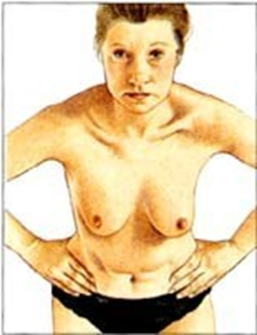
Inspection before a mirror
Stand and face a mirror with your arms relaxed at your sides or arms resting on your hips; then turn to the right and left for a side view look. (look for any flattening in the side view
Bend forward from the waist with arms raised overhead

Slide 13
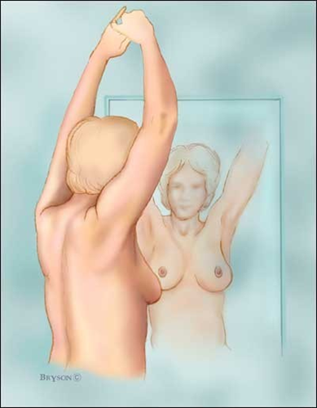
Cont…
Stand straight with arms raised over the head and move the arms slowly up and down at the sides. (look for free movement of the breasts over the chest wall)
Press your arm firmly together at the chin level while the elbows are raised to shoulder level.

Slide 14
Palpation: Lying Position
Place a pillow under your right shoulder and place the right hand behind your head. This position distributes breast tissues more evenly on the chest.
Use the finger pads (tips) of the three middle fingers (held together)on your left hands to feel the lumps.
Press the breast tissue against the chest wall firmly enough to know how your breast fells. A ridge of firm tissue in the lower curve of each breast is normal.

Slide 15
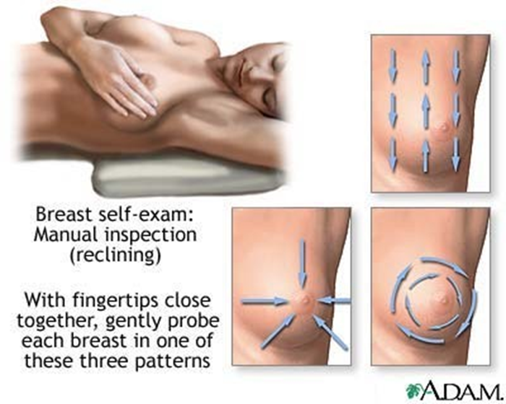
Cont…
Use circular motions systematically all the way around the breasts as many times as necessary until the entire breast is covered.
Bring your arm down to your side and feel under your armpit, where breast tissues are also located.
Repeat the exam on your left breast using the right finger pads of your right hand.

Slide 16
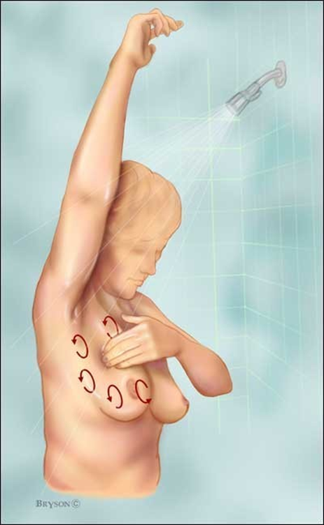
Palpation: Standing or Sitting
Repeat the examination of both breasts while upright with one arm behind your head. This position makes it easier to check the upper part of the breast and toward the armpit.
Optional: Do the upright BSE in the shower. Soapy hands glide more easily over when wet
Report any changes to your health care provider

Slide 17
Conclusion
Awareness regarding breast self examination among women is useful and it is the most important viable tool for early detection of cancer. Cancer is the second leading cause of mortality and morbidity in both developed and developing countries. BSE is the only feasible and reasonable approach in early detection of breast cancer

